Slide 1
Modelling business workflows
with sagas

Slide 2
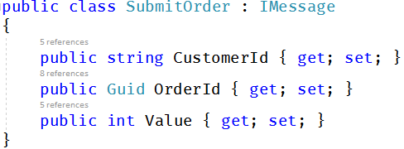
Recap - Messages
Notes:
Just a plain .NET class used for comms between two parts of your system.
The marker interface is the default convention but you can create your own conventions

Slide 3
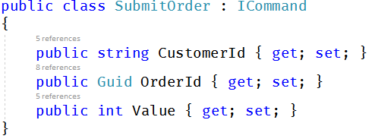
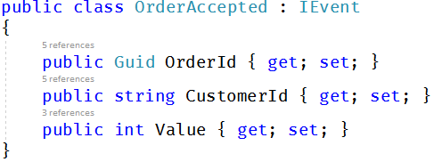
Recap - Commands and Events
Notes:
Two basic sub-types of message: Commands and Events Commands are imperative. They tell you to do something. You send a command to a single destination
Events are informative. They tell you something has happened. You publish an event and interested parties subscribe to it

Slide 4
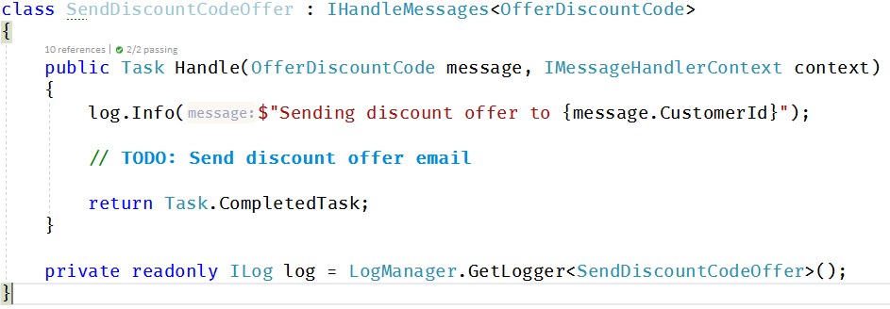
Recap - Message Handlers
Notes:
A message handler is code that is run when a message is received. It implements IHandleMessages<T> where T is the message type.
Message handlers don’t care if they’re handling commands or events, they all look the same

Slide 5
Sample App
Client
Customer Relations
OrderAccepted
SubmitOrder
Sales
Notes:
Fake Client that can submit orders for a couple of customers. You can imagine this stands in for a web application.
Sales that takes an order and converts it into an event, this simulates billing and shipping and whatever else. The event indicates that the order has been shipped
Customer Relations responds to order shipments and sends an order shipped email (simulated)

Slide 6
New Business Requirement
When a new customer has made 5 orders, send them a discount code.
Notes:
Uncomment CustomerRelations -> OfferDiscountForRepeatCustomersSaga
We could probably get rid of the DiscountOfferSent flag and just say if(Data.OrderCount == 5). Over time the exact rules around when to send the discount offer can change and explicitly storing whether or not we have sent it can reduce the chances of sending it again. It’s one boolean value in the database.
Note that saga does not send an email, it sends a message. The decision is transactional and isolated from the infrastructure. If the email service is down, the decision is still made. We could publish an event here called RepeatCustomerDetected and then hook all sorts of handlers onto it for the application to respond to that business event.

Slide 7
New Business Requirement
Cancellations are expensive. We may have to reverse credit card transactions, etc.
Most cancellations happen in the first 10 minutes.
When an order is submitted, we want to wait 10 minutes before we can accept it.
Notes:
Comment out Sales -> OrderHandler
Uncomment Sales -> BuyersRemorsePolicy
Note the NotImplementedException when an Order is Cancelled after it has been Accepted. This will go straight to the error queue, where it will get picked up by the platform for manual inspection. If it is handled manually, the message can be archived. If you start getting a lot of them, you can update the saga code, and then replay all those messages!
Timeouts don’t need an explicit mapping. They came from the saga so we know which saga instance they need to go back to.
Can be started by OrderCancelled? That’s because the queues do not guarantee ordering. The Cancellation request may arrive before the SubmitOrder command!
The Value and CustomerId gets passed via the Timeout message. It could also be stored in the saga data. Which approach do you prefer?
How is this saga going to change over time as the business grows? Can we give partial refunds? Will this handle returns or would that perhaps become its own saga?
Check out the unit testing project for an extremely basic unit test of this saga. Create the instance, set up the data, pass it the next message, make assertions about it’s state or the messages it emits.

Slide 8
New Business Requirement
If a customer makes at least $400 of orders within 90 days,
offer them a gold membership
Notes:
Uncomment CustomerRelations -> GoldCustomerPolicy
Note the use of timeouts to implement the sliding window. We don’t need to store the details of every order and when they were created. We also don’t need to query for a list of orders. We can simply say “if you’ve passed the threshold, then you get the offer” and the timeouts take care of the sliding window for us.

Slide 9
Other requirements
If a customer doesn’t submit a shopping cart within 24 hours of adding the first item to it, send them a reminder email.
If they still don’t respond, send them another reminder in 7 days
If a shipping supplier doesn’t respond to a request within 2 hours, submit the request to a backup shipping supplier
If both get back to you confirming the order, send an email to the shipping manager who will manage it by callings and cancelling one of them
If a credit card is denied, send the customer an email informing them and offering to hold their order for 48 hours. Provide the ability for them to log in and update their payment method (or try again)
If we’re out of stock, order from the supplier and notify the customer that their shipment is on back-order.
Notes:
Note: There isn’t the code to simulate all of the messages needed to implement these. It’s just to give you an idea of what sorts of sagas you could create.
Customer requirements are often worded to trigger off of events. “When this happens, do this.” or “If this happens, then do that.” or even “30 days before the policy expiry date, send an invoice.”

